Slide 1
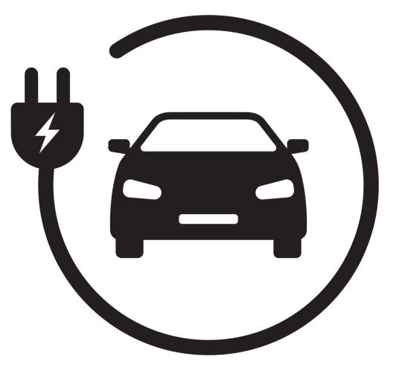

Predicting of EV Charging Behavior using Machine Learning Techniques
In Order to have clean air in cities, you have to go Eletric
Elon Musk

Slide 2

Agenda
Problem Definition
Related Work
Data Description
Feature Engineering
Machine Learning Models Used in this Study
Experimental Setup and Model Selection
Results and Discussion
Conclusion

Slide 3
Problem Definition/ Introduction
Climate change has become a growing concern in recent years
Global energy consumption is a major contributor to the climate crisis
Studies have shown that electric vehicles (EVs) have the potential to reduce carbon emissions by 45% compared to conventional internal combustion engine (ICE) vehicles
EVs were initially limited by factors such as reliability and battery range, which have significantly improved in recent years and led to an increase in EV popularity
There still remains a few challenges, most notably the charging time and public charging needs, despite the promising potential
To avoid power grid degradation and failures, un-coordinated charging behavior must be avoided.
The optimal solution is to better manage the scheduling of charging stations. The research on smart scheduling using data driven approaches are plentiful and include optimization
Our study concludes that machine learning based approaches are more suitable to scheduling approaches with the ability to provide quantification and more realistic representation

Slide 4

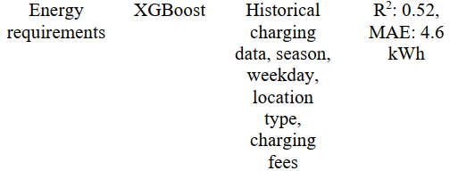
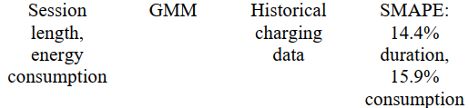
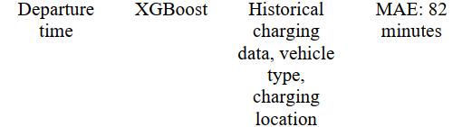

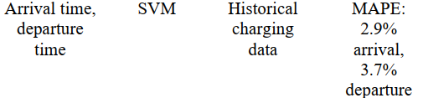

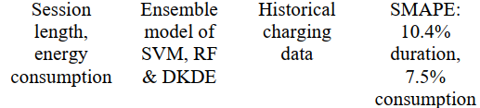
Related Work/ Charging Behavoir
Although predictions of EV charging behavior can have various categories, the focus of this work was on session duration and energy consumption
Examples of other charging behavior
Prediction of whether the Evs will be charged the next day
Identification of the use of fast charging
Prediction of the time to next plug
Charge profile prediction
Charging speed prediction
Prediction of charging capacity and the daily charging times
Symmetric mean absolute percentage errors (SMAPE)

Slide 5
Data Description
Charging dataset has been used for the task
To make prediction more effective, we also make use of following datasets
Weather Data
Traffic Data
Local events data
Scheduling of EV charging is more significant in public charging structures due to the unpredictable nature of the charging behavior, especially in places like shopping malls.
The ACN dataset is among the few publicly available datasets for non-residential EV charging and will be utilized in this work.
The dataset contains charging records from two stations
The dataset can be accessed from by either a web portal or python application programming interface (API)
we have used traffic data from google maps
“ACN-Data -- A Public EV Charging Dataset.” https://ev.caltech.edu/dataset

Slide 6
Feature Engineering
Feature engineering refers to the transformation of data into meaningful representation using human knowledge. This process is labor intensive but important nonetheless as this is a weakness of the learning algorithms.
Feature Used for ML
Length of charging duration, target variable
Session energy consumption, target variable
Numerical representation of the connection time (arrival time)
Day of the week, one-hot encoded
Binary variable indicating whether the session took place in a weekend
whether the session took place on a US federal holiday
Feature Used for ML
Sine and Cosine components of the hour
Sine and Cosine components of the day
Sine component of the month
Historical average departure time
Historical average consumption
Historical average session length
average traffic level after arrival
Feature Used for ML
maximum traffic level after arrival
total campus events after arrival
average temperature of last 7 hours
average temperature of next 10 hours
average humidity of last 7, 10 hours
average wind speed of last 7, 10 hours
average rainfall of last 7, 10 hours
Feature Used for ML
average snowfall of last 7 and 10 hours
average snow depth of last 7 and 10 hours
average wind speed of last 7, 10 hours
average rainfall of last 7, 10 hours

Slide 7
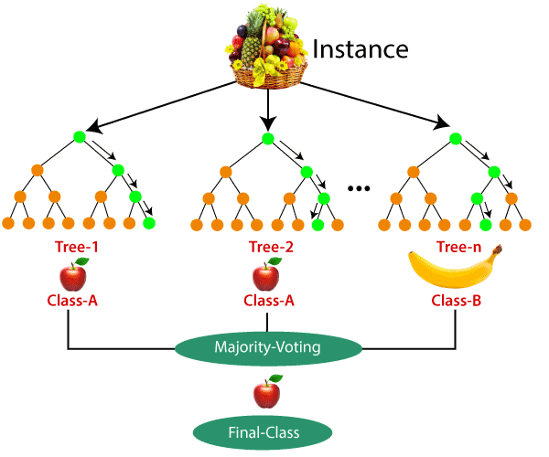

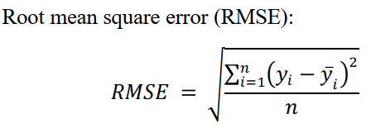
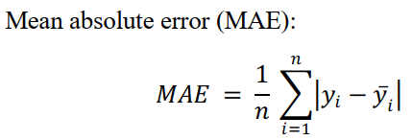
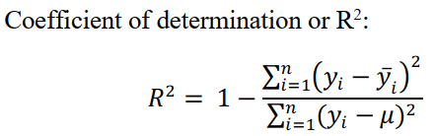
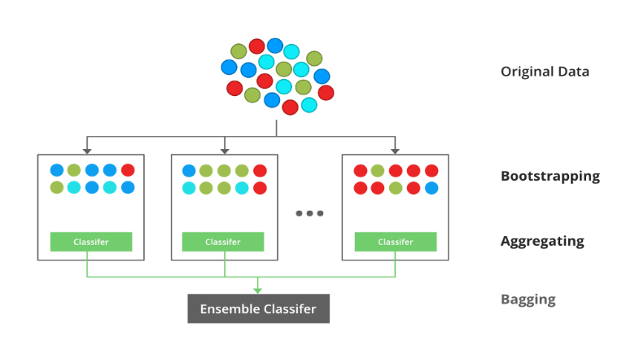
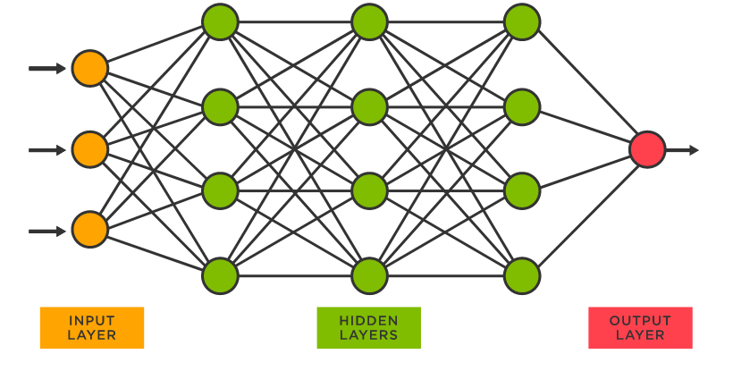
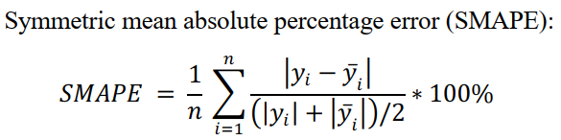
Machine Learning Models Used in this Study
We use several machine learning algorithms including Random Forest, Support Vector Machines, XGBoost and Artificial Neural Network for predictions of session duration and energy consumption on the adaptive charging network (ACN) dataset. Metrics used to Evaluate models
3 hidden layers of 64, 32 and 16 nodes
Rectified linear units (Relu) was used as the activation function for all hidden layers
output layer contained a linear activation
learning rate value was set to 0.001
Adam algorithm for model optimization
Training batch size was 32
Number of iterations were 15 epochs.

Slide 8
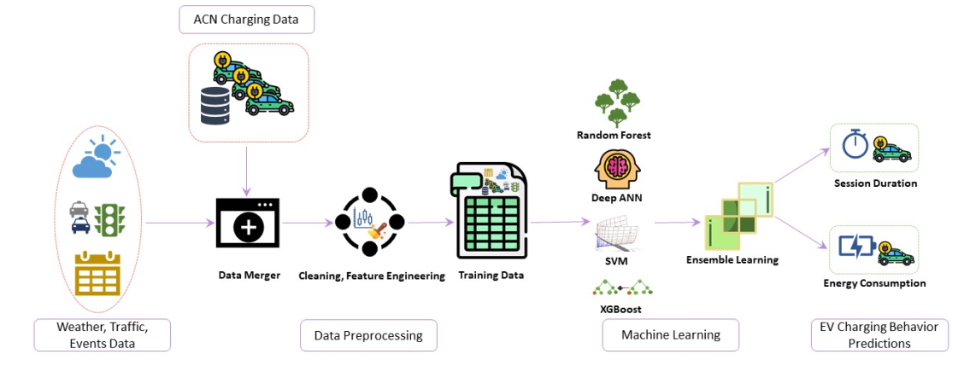
Experimental Setup and Model Selection
Proposed Framework was
Data from both sources are merged
Missing values, Outlier Detection, Encoding etc.
Prediction of Target Variable
70% data for training, 30% for testing + K-Fold

Slide 9
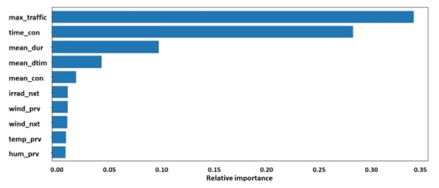
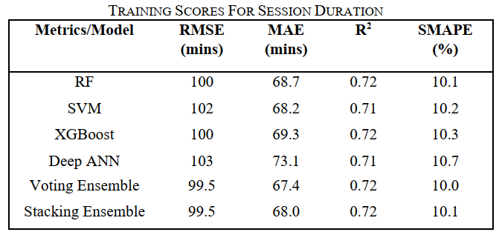
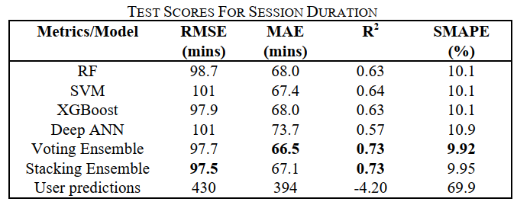
Results & Discussion – Session Duration
Feature Importance Calculated by Random Forest
Training and Testing Performance

Slide 10
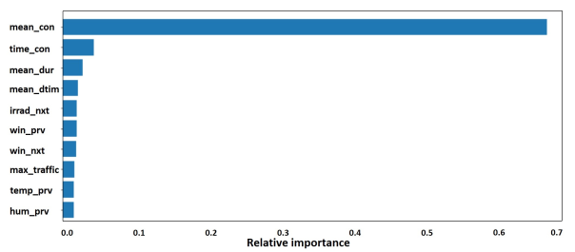
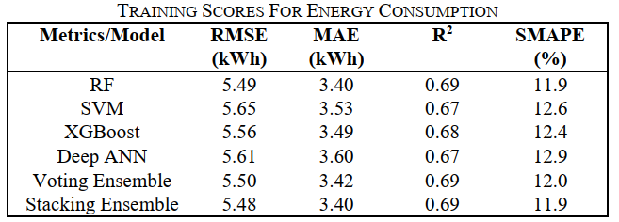
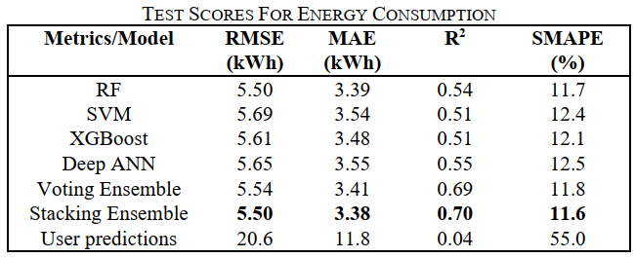
Results & Discussion – Energy Consumption
Feature Importance Calculated by Random Forest
Training and Testing Performance

Slide 11
Conclusion
In that work, we presented a framework for the prediction of two of the most important EV charging behaviors with regards to scheduling, namely EV session duration and energy consumption. We utilized weather, traffic, and events data along with the historical charging data. We trained four popular ML models along with two ensemble learning algorithms for the prediction of charging behavior. The results obtained in terms of prediction performance is superior to the results in the previous works. We have also provided a significant improvement of charging behavior prediction on the ACN dataset and demonstrated the potential of utilizing traffic and weather information in charging behavior prediction.

Slide 12
Key Contribution of the Study
We proposed a novel approach in EV charging behavior prediction that utilizes weather, traffic, and local events data along with historical charging records.
We used several machine learning algorithms including RF, SVM, XGBoost and ANN for predictions of session duration and energy consumption on the adaptive charging network (ACN) dataset.
We empirically showed that the use of additional data has a positive impact on the accuracy of predictions and significantly improves upon the previous work on the same dataset that used only historical charging information.

Slide 13

Data Science Use Cases in HR

